Slide 1

Vel Tech Rangarajan Dr. Sagunthala R&D Institute of Science and Technology
School of Computing
Department of Computer Science and Engineering
10211CS224 / FULL STACK APPLICATION DEVELOPMENT (JAVA)
PROJECT REVIEW : MILESTONE PROJECT – 1
Date: 24-03-2026
Full-Stack Skill Learning Academy Marketplace with Secure Authentication
SDG: SDG 4 – Quality Education
Presented By:
Batthina Jayanthi– VTU25786 – 23UECS0951
Courses Handling Faculty:
Dr. Hafizur Rahman-Associate Professor

Slide 2
INTRODUCTION
1
In today’s digital era, online learning platforms are essential for acquiring skills in a structured and efficient way.
Many learners depend on unorganized resources, which leads to confusion and lack of proper guidance.There is a growing need for a simple, structured, and automated system to manage expenses efficiently.
There is a growing need for a centralized platform that provides structured learning along with secure user access.
The Skill Learning Academy Marketplace is a full-stack web application developed to provide users with a platform to explore, enroll, and learn courses online.
The system uses a MySQL database to maintain relational data between users, courses, and enrollments.
It provides secure authentication using login and registration modules to ensure safe user access.
The application is developed using HTML, CSS, Bootstrap for frontend and PHP with MySQL for backend, running on a local server using XAMPP.
2
3
4
5
6
7
8
9

Slide 3
PROBLEM STATEMENT
1
In today’s fast-paced digital world, acquiring new skills has become essential for students and professionals. Many learners still rely on unstructured resources such as random videos, notes, or scattered online materials, which often leads to confusion and ineffective learning. These traditional methods lack proper organization and do not provide a clear learning path. Additionally, there is no centralized system to manage courses, track user enrollments, and deliver structured learning content efficiently. Existing e-learning platforms are often expensive, overly complex, or not accessible to all users. Furthermore, the absence of secure authentication can lead to data privacy issues and unauthorized access. Without a reliable and structured platform, users find it difficult to explore courses, enroll, and continue learning effectively. Therefore, there is a strong need for a simple, secure, and cost-effective web-based learning marketplace that provides structured content, secure access, and an efficient learning experience.
2
3
4
5
6
7
8
9

Slide 4
OBJECTIVE(S)
1
2
To design and develop a responsive web-based Skill Learning Academy Marketplace that allows users to explore, enroll, and learn courses using HTML, Bootstrap, PHP, and MySQL.
To implement secure authentication and CRUD operations for managing users, courses, and enrollments, ensuring safe access and efficient learning through a relational database system.
3
4
5
6
7
8
9

Slide 5
PROPOSED SYSTEM
Complete Learning Marketplace Solution – The Skill Learning Academy Marketplace is a web-based full-stack application that allows users to register, browse courses, enroll, and learn — providing a complete platform for skill-based education.
Secure Authentication – Implements secure user registration and login using PHP and session management to ensure safe access and protect user data.
Dynamic Course Management – Courses are stored in a MySQL database and displayed dynamically, allowing users to view course details and enroll in real time.
Relational Database Structure – Maintains relationships between Users, Courses, and Enrollments using primary and foreign keys for structured and consistent data management.
Personalized Dashboard & Learning – Users can view enrolled courses, track progress, and continue learning through a personalized dashboard interface.
Fully Responsive Web Design – Designed using Bootstrap to ensure compatibility across desktop, tablet, and mobile devices.
How It Solves Problems of Existing Systems – • Provides a centralized platform for structured learning • Eliminates unorganized learning resources • Ensures secure user authentication • Simplifies course enrollment and access • Offers a cost-effective and easy-to-use solution
Key Advantages –Secure Authentication, Structured Learning System, Relational Database Management, Easy Course Enrollment, Responsive Design, Scalable Architecture.
1
2
3
4
5
6
7
8
9

Slide 6
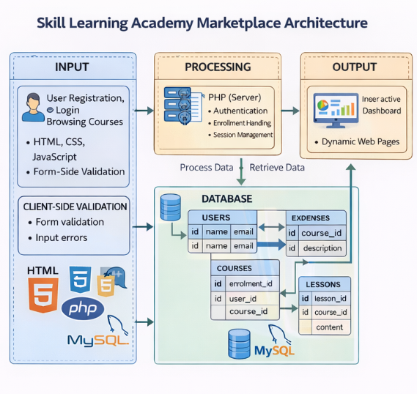
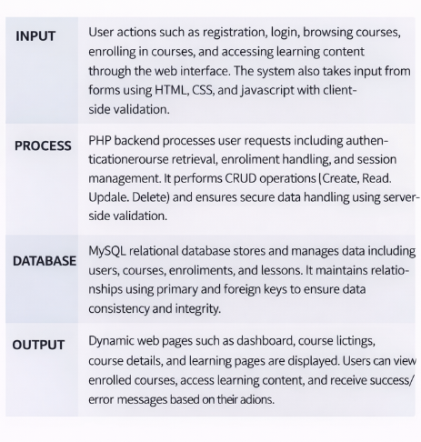
PROPOSED SYSTEM ARCHITECTURE
1
2
3
4
5
6
7
8
9

Slide 7
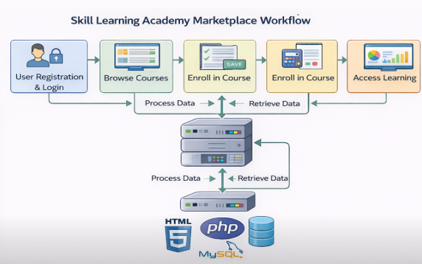
WORKFLOW
1
2
3
4
5
6
7
8
9

Slide 8
TECHNOLOGIES USED
1
2
Frontend: HTML, CSS, Bootstrap , JavaScript
Backend: PHP, CRUD Operations, Server-side Validation, Authentication Logic
Database: MySQL, Users Table, Courses Table, Enrollments Table, Lessons Table, Relational Mapping (Foreign Key)
Tools: XAMPP, phpMyAdmin, VS Code, Web Browser
Hardware Requirements: Minimum 4GB RAM, 20GB free storage, Intel i3 processor or above
Software Requirements: Windows / Linux / macOS, Apache Server, PHP 7.4 or above, MySQL 5.7 or above, Modern Web Browser
3
4
5
6
7
8
9

Slide 9
MODULE DESCRIPTION
Module 1: User Authentication & Management
This module manages user registration, login, and session handling within the system. It allows users to create accounts and securely log in using authentication mechanisms. Each user is uniquely identified, and session management ensures secure access to different parts of the application.
Module 2: Course Management
This module handles all course-related operations including adding, viewing, and managing course details. It stores information such as course title, description, and content. Courses are dynamically displayed to users for easy browsing and selection.
Module 3:Enrollment Management
This module manages the enrollment process where users can enroll in available courses. It maintains the relationship between users and courses using foreign keys. It ensures that each user’s enrolled courses are tracked properly.
Module 4:Learning & Dashboard Module
This module allows users to access learning content and continue their courses through a personalized dashboard. It displays enrolled courses, learning progress, and provides an interactive interface for users to navigate and learn efficiently.
1
2
3
4
5
6
7
8
9

Slide 10
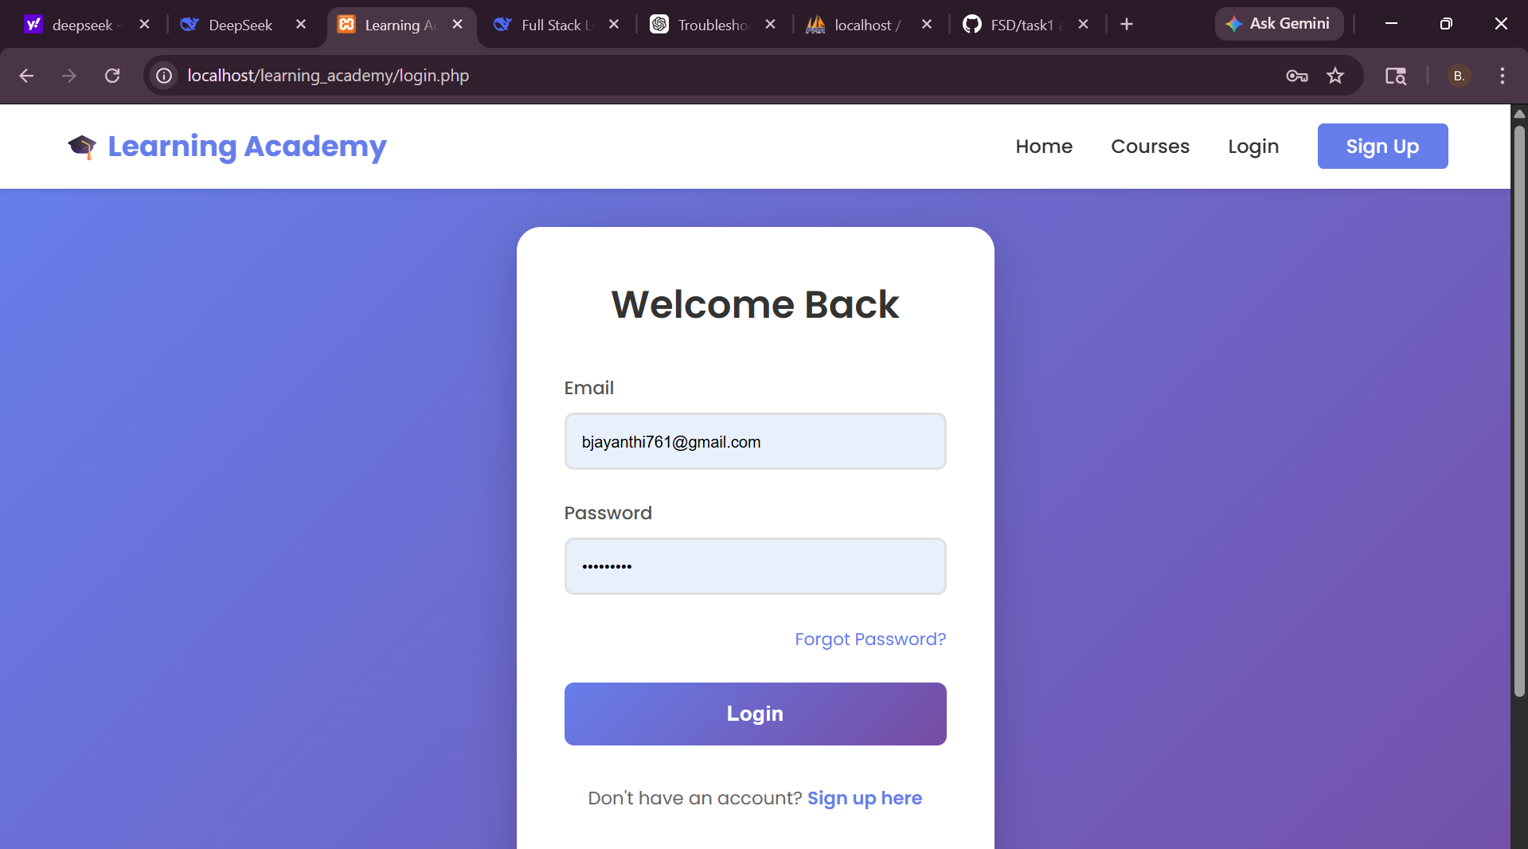
IMPLEMENTATION SCREENSHOTS
1
2
3
4
5
6
7
8
9
User Authentication & Management
This module manages user registration, login, and session handling within the system. It allows users to create accounts and securely log in using authentication mechanisms. Each user is uniquely identified, and session management ensures secure access to different parts of the application.

Slide 11
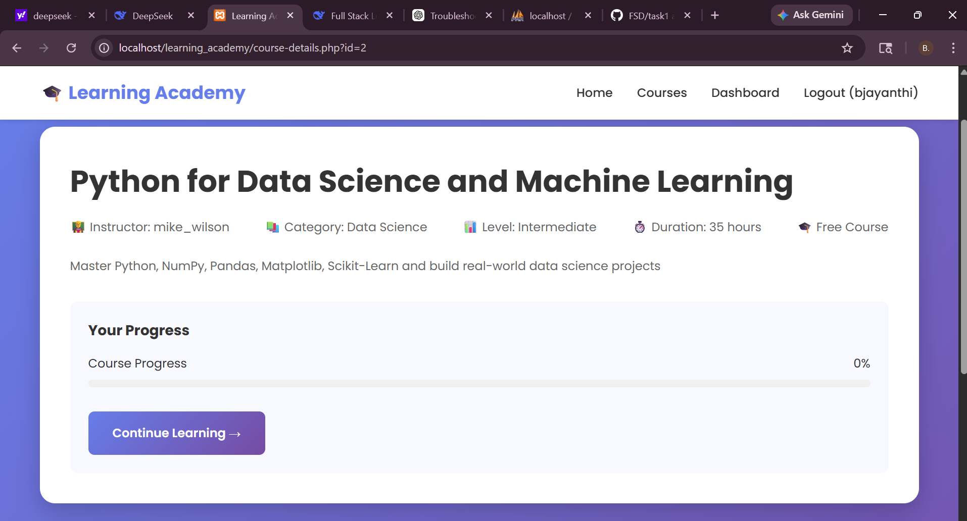
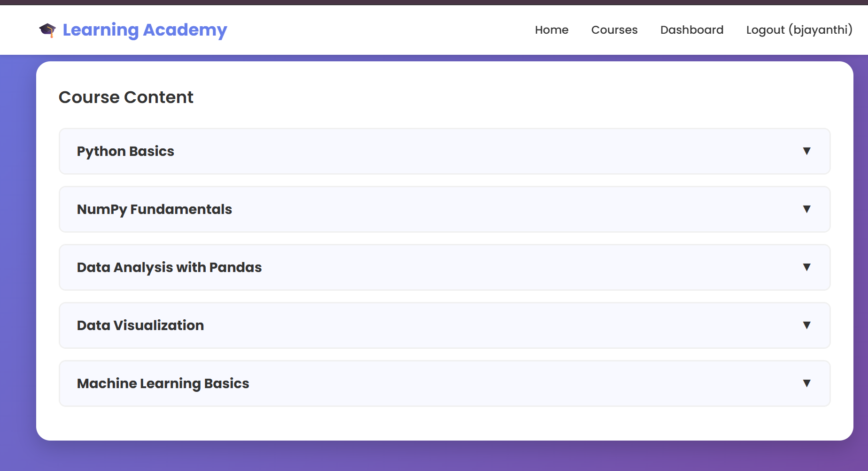
IMPLEMENTATION SCREENSHOTS
1
2
3
4
5
6
7
8(A)
9
Course Management
This module handles all course-related operations including adding, viewing, and managing course details. It stores information such as course title, description, and content. Courses are dynamically displayed to users for easy browsing and selection.

Slide 12
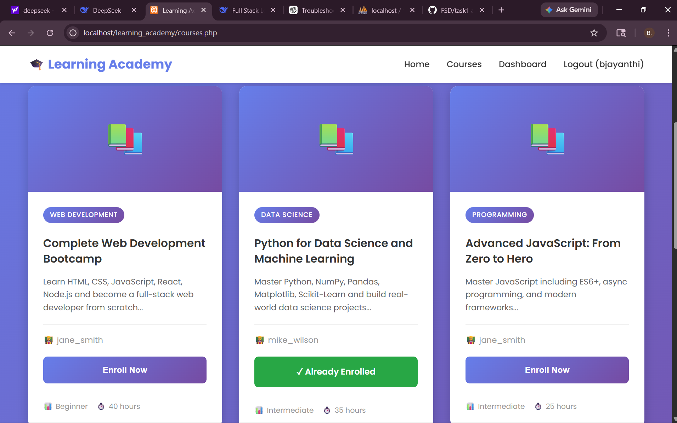
IMPLEMENTATION SCREENSHOTS
1
2
3
4
5
6
7
8(B)
9
Enrollment Management
This module manages the enrollment process where users can enroll in available courses. It maintains the relationship between users and courses using foreign keys. It ensures that each user’s enrolled courses are tracked properly.

Slide 13
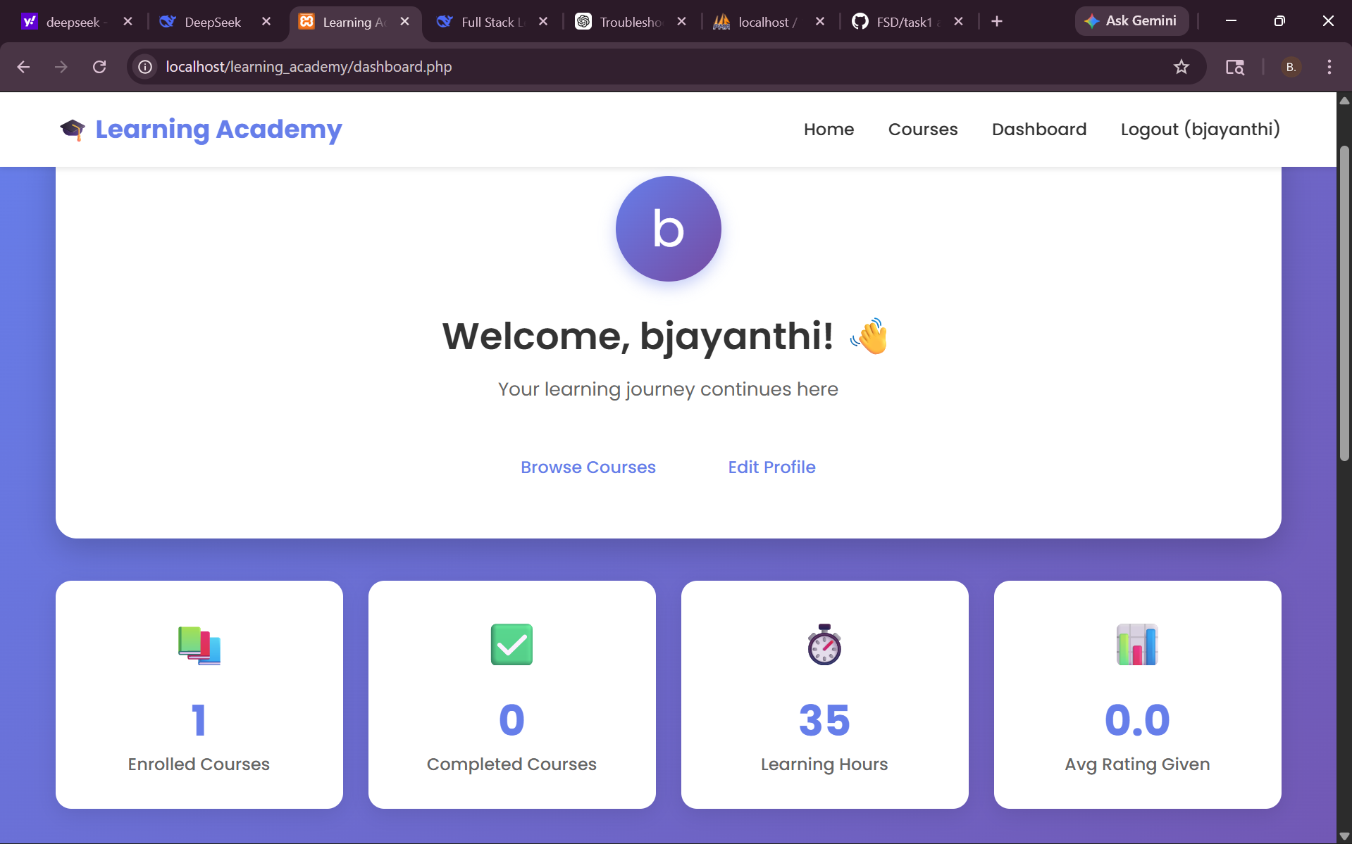
IMPLEMENTATION SCREENSHOTS
1
2
3
4
5
6
7
8(C)
9
Learning & Dashboard Module
This module allows users to access learning content and continue their courses through a personalized dashboard. It displays enrolled courses, learning progress, and provides an interactive interface for users to navigate and learn efficiently.

Slide 14
ADVANTAGES & LIMITATIONS
1
Advantages:
•Simple and user-friendly interface for easy learning and navigation. • Secure authentication system for safe user access. • Efficient relational database structure ensuring data integrity. • Supports full CRUD operations for users, courses, and enrollments. • Structured learning system with course enrollment and dashboard. • Responsive design compatible with desktop and mobile devices.
Limitations:
•No payment gateway integration for course purchases. • Limited advanced features like live classes or video streaming. • Application runs locally and is not deployed on the cloud. • No advanced analytics or graphical progress tracking.
2
3
4
5
6
7
8
9

Slide 15
Thank you

